Slide 1
Inteligenta artificiala sem 1
Sisteme inteligente (sem2)
Anca Marginean
sala 21, Baritiu 26-28
Teams: Inteligenta artificiala 2026/2027
Moodle: Inteligenta Artificiala, Seria A, Sem. 1 2026/2027 (moodle.cs.utcluj.ro)
Enrollement key: , X={1,2,3,4,5}.
anca.marginean@cs.utcluj.ro
TAs:
  Cristina Feier
  Oana Zaharia
  Raluca Mercas
  Tania Pantea
  Bogdan Sipos

Slide 2
Evaluare
Examen 60% + Laborator 40% daca examen >=4 Altfel Examen
Laborator: C1, C2, C3

Slide 3
Bibliografie
Artificial Intelligence: A Modern Approach (4th edition) Stuart Russell, Peter Norvig
http://aima.cs.berkeley.edu + Aima code https://github.com/aimacode + link moodle
Stuart Russell - University of California, Berkeley
  B.A. with first-class honours in physics from Oxford University in 1982, and his Ph.D. in computer science from Stanford in 1986.
  Director of the Center for Intelligent Systems, University of California Berkeley
  Adjunct Professor of Neurological Surgery, University of California, San Francisco
  1990, he received the Presidential Young Investigator Award of the National Science Foundation; in 1995 he was cowinner of the Computers and Thought Award.
Peter Norvig -ex Director of Research at Google
  director responsible for the core Web search algorithms from 2002 to 2005
  previously, head of the Computational Sciences Division at NASA Ames Research Center
view Aima adoptions

Slide 4
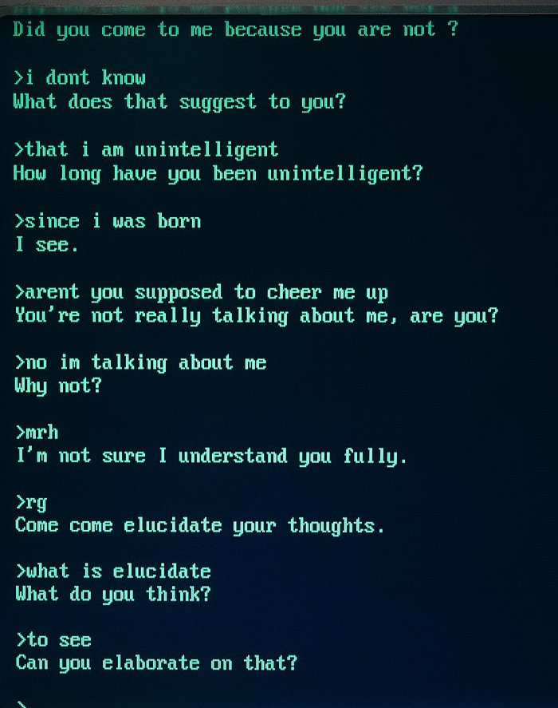
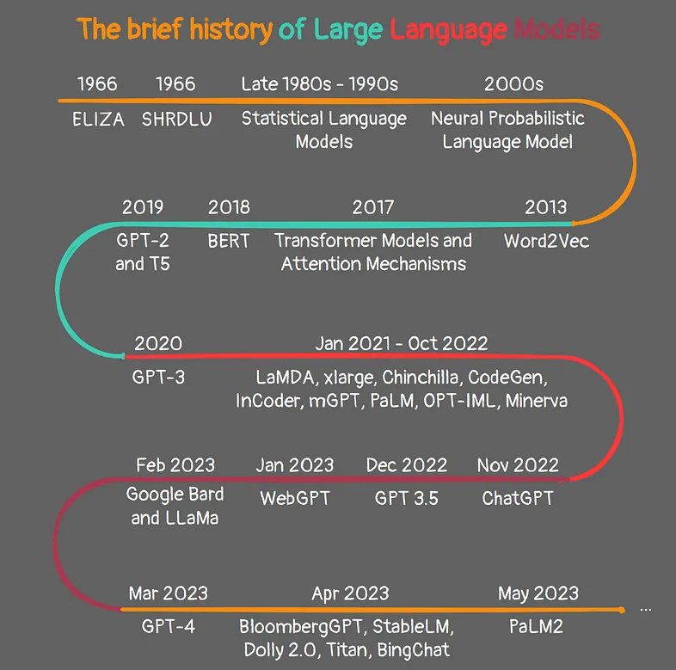
Language Models
Large Language Models
Attention is all you need
BERT: Pre-training of Deep Bidirectional Transformers for Language Understanding

Slide 5
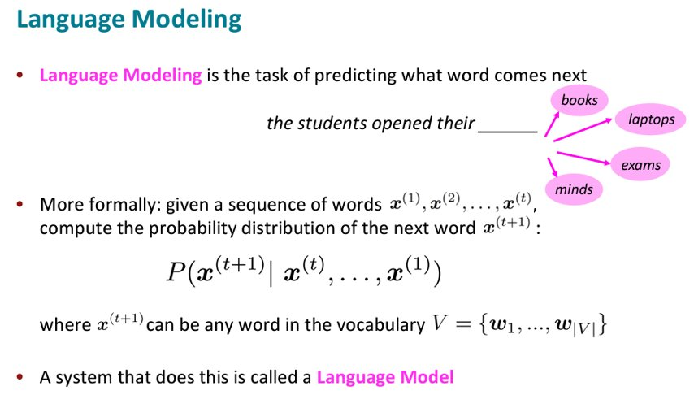
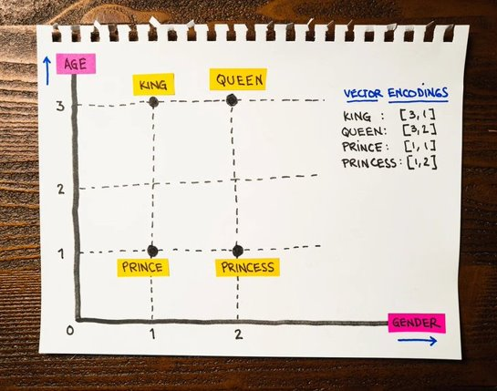
Words are Dense vectors

Slide 6

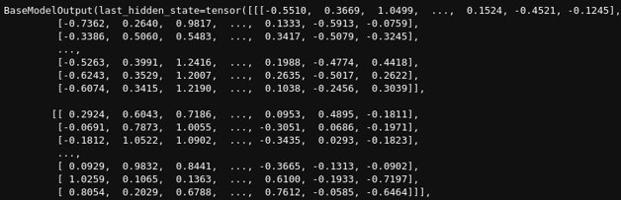
How does a language model "see" the text?
The semester is over
Peter is learning at TUCN.

Slide 7
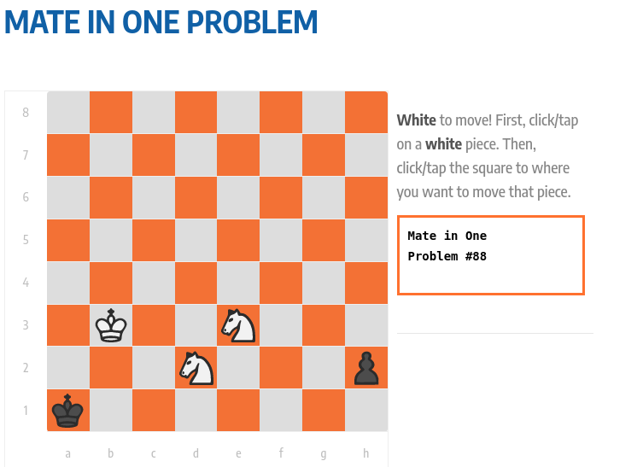
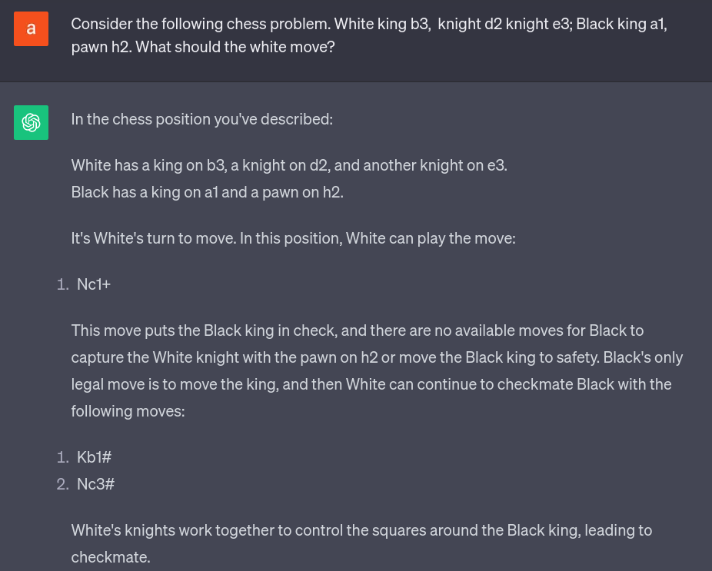

Slide 8
https://fortune.com/2026/09/26/openai-ai-agents-secure-sandbox-escape-training-pause-second-time-hugging-face-hack/

Slide 9
Ce e AI?

Slide 10

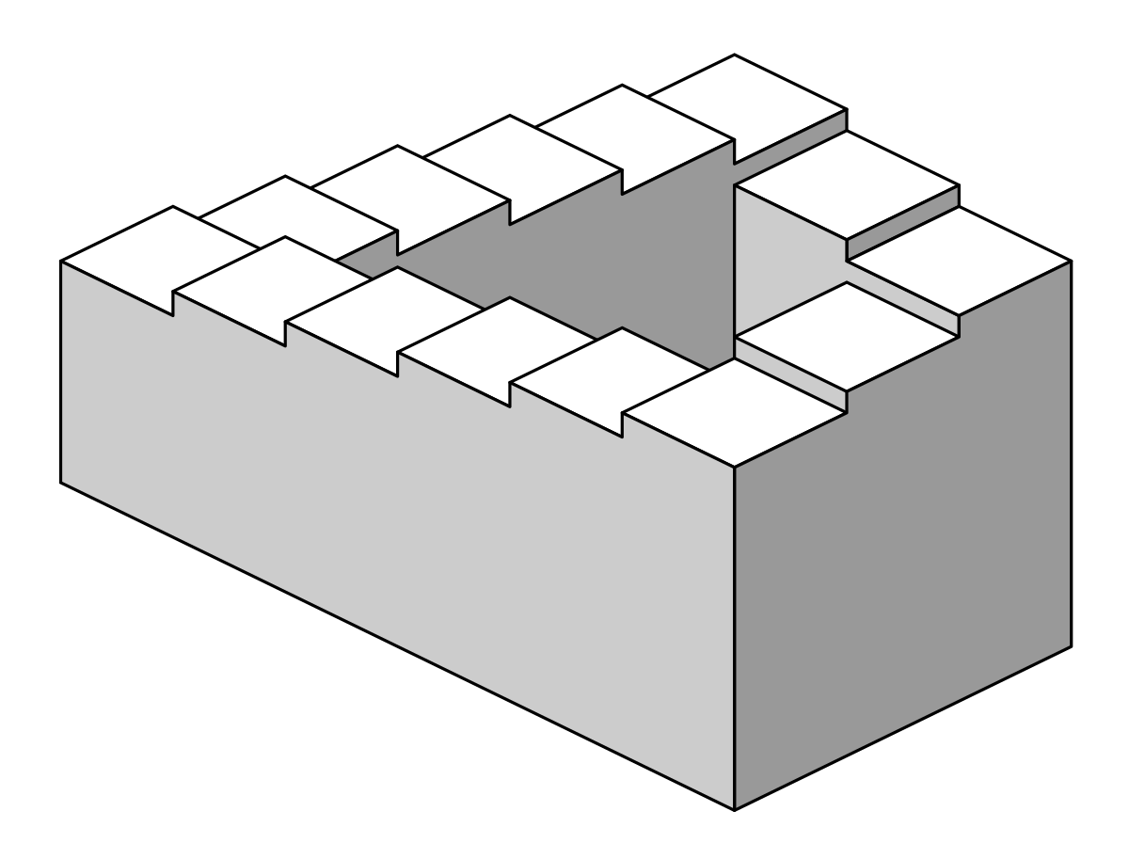
statistics
Symbolic AI
logics
Machine
learning
Intelligence
Artificial

Slide 11
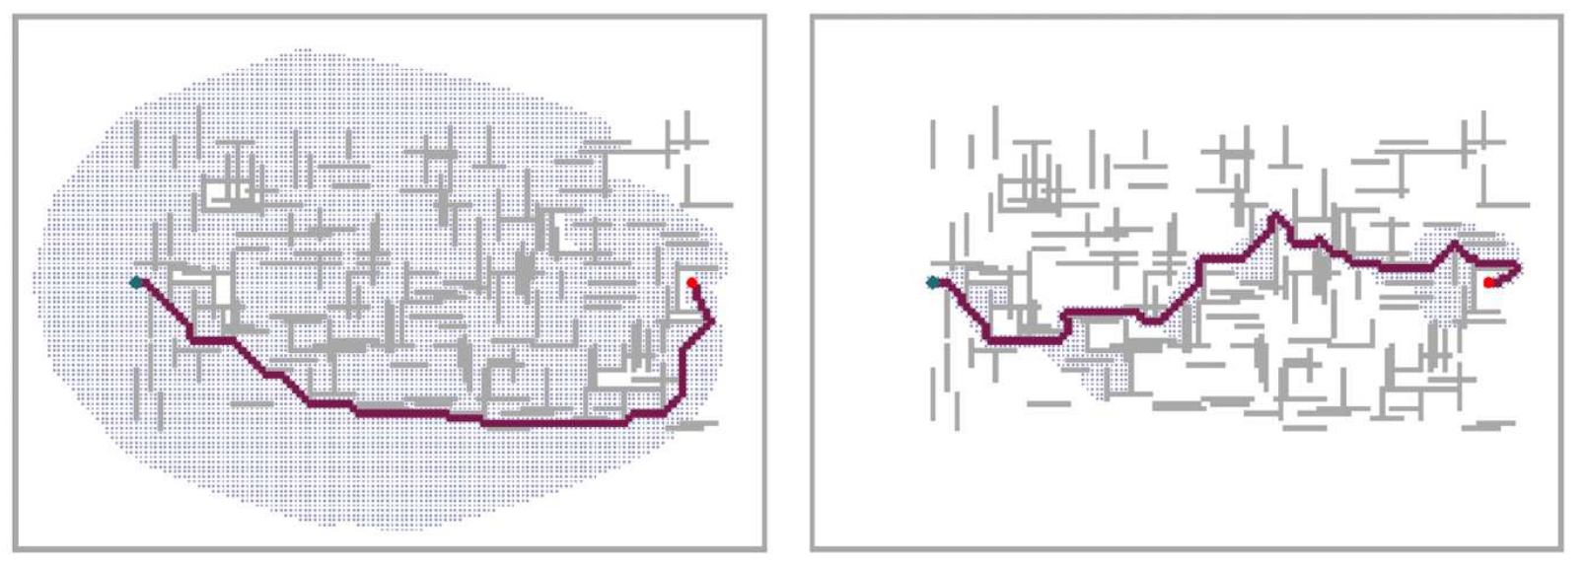
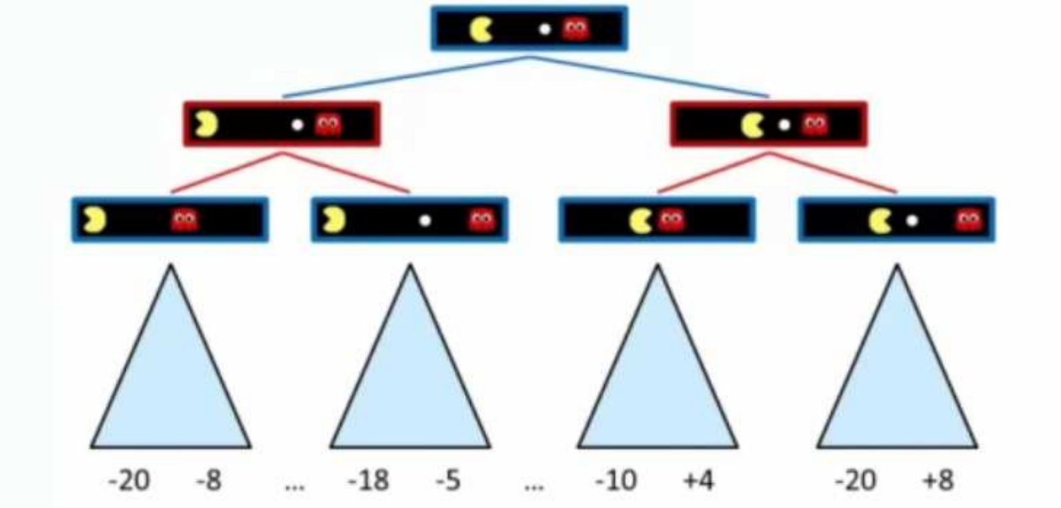
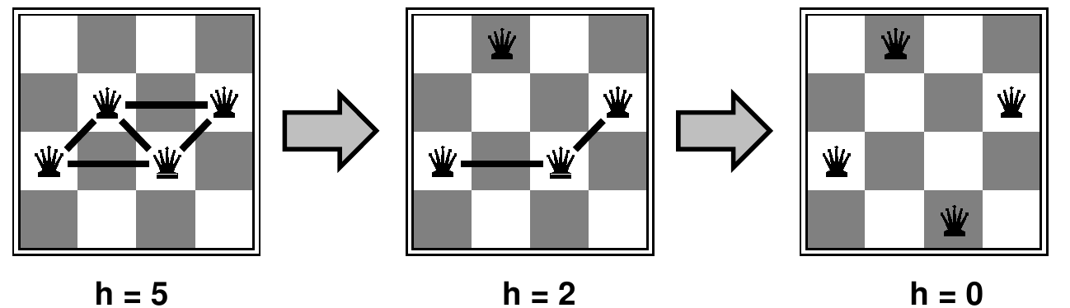
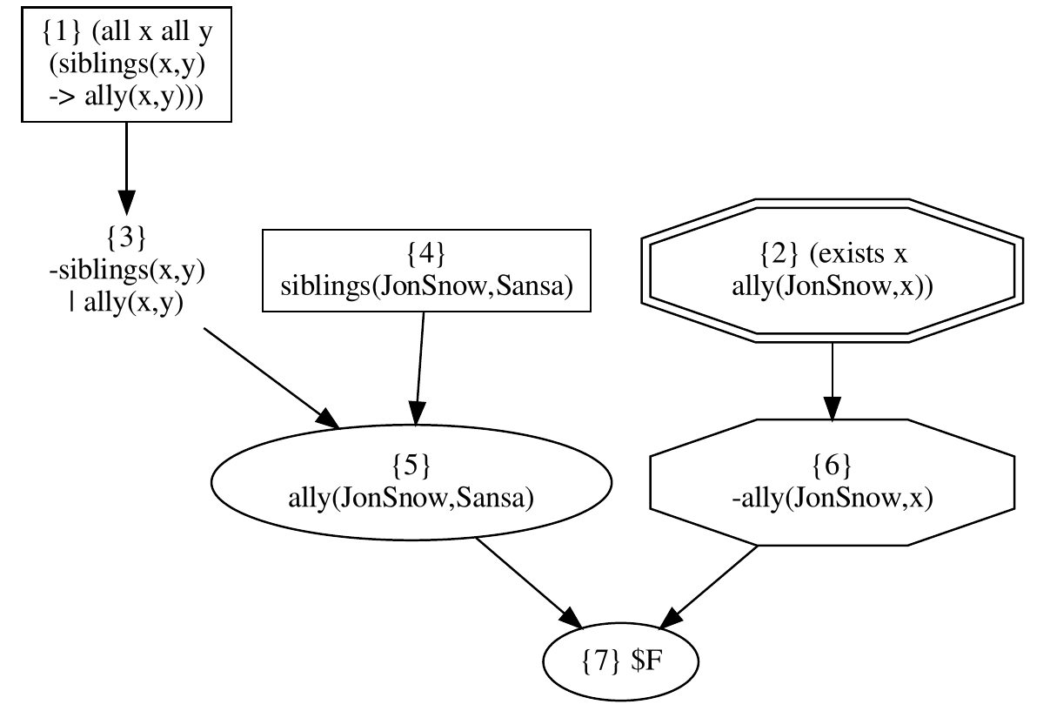
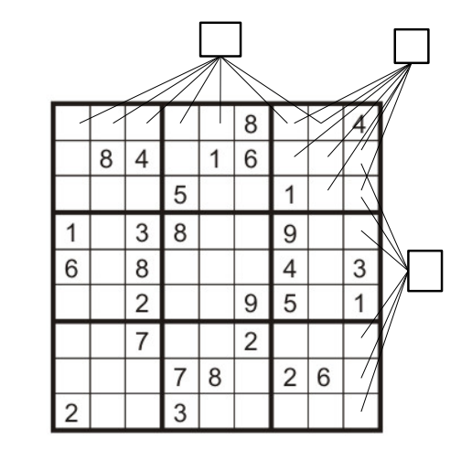
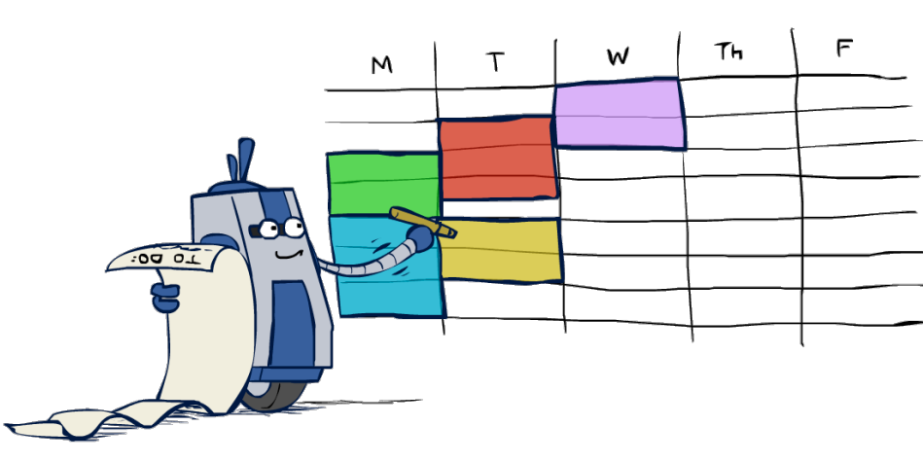
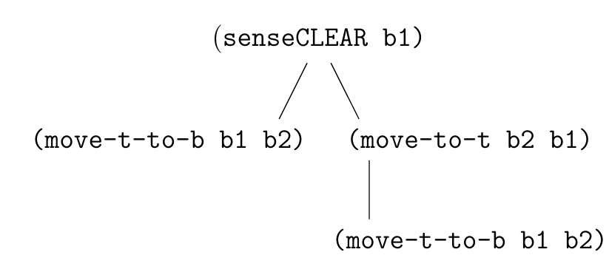
Informed Search
Adversarial Search
Sansa and Jon Snow are siblings.
Let's assume that any two siblings are also allies.
Can we prove that JonSnow has at least one ally?
siblings(JonSnow, Sansa).
all x all y (siblings(x,y) -> ally(x,y)).
king(JonSnow).
exists x ally(JonSnow, x).
Local Search
(:action Attack
:parameters (?attacker ?target - character)
:precondition (and (Alive ?attacker) (Alive ?target))
:effect (and (Damaged ?target) (DecreaseHealth ?target)) )
Contingency Planning
Conformant planning
Constraint
satisfaction problem
Logics*
Planning *
Symbolic AI

Slide 12
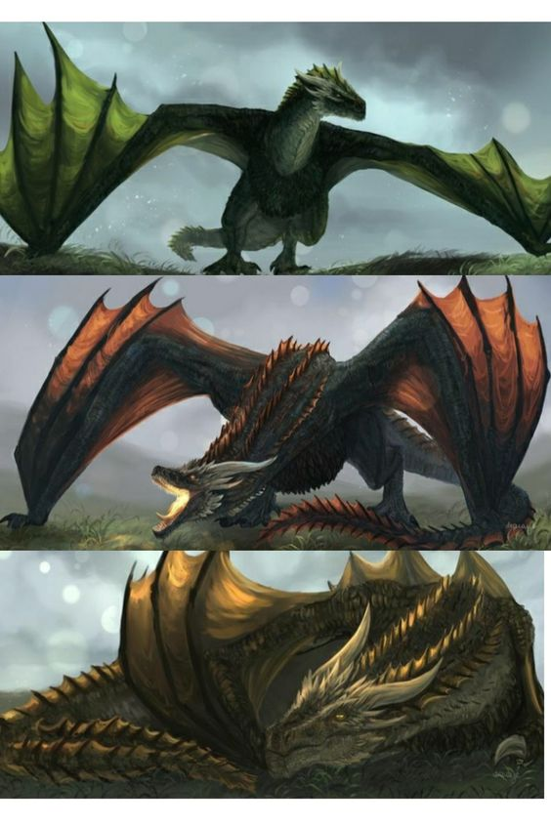
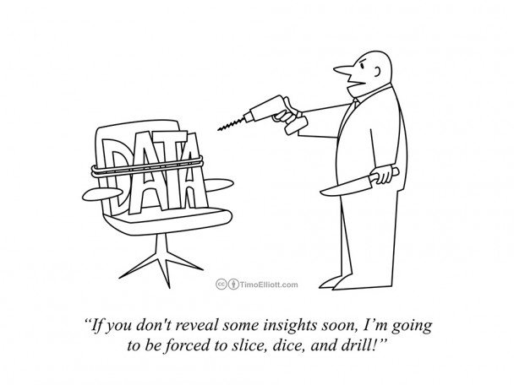
Supervised Learning.
Unsupervised Learning
Self-supervised Learning
Learning from DATA
Reinforcement Learning
Learning from EXPERIENCE
Neural Networks
Transformers
Diffusion Models
Architectures & Loss Functions
Machine Learning.
Deep Learning

Slide 13
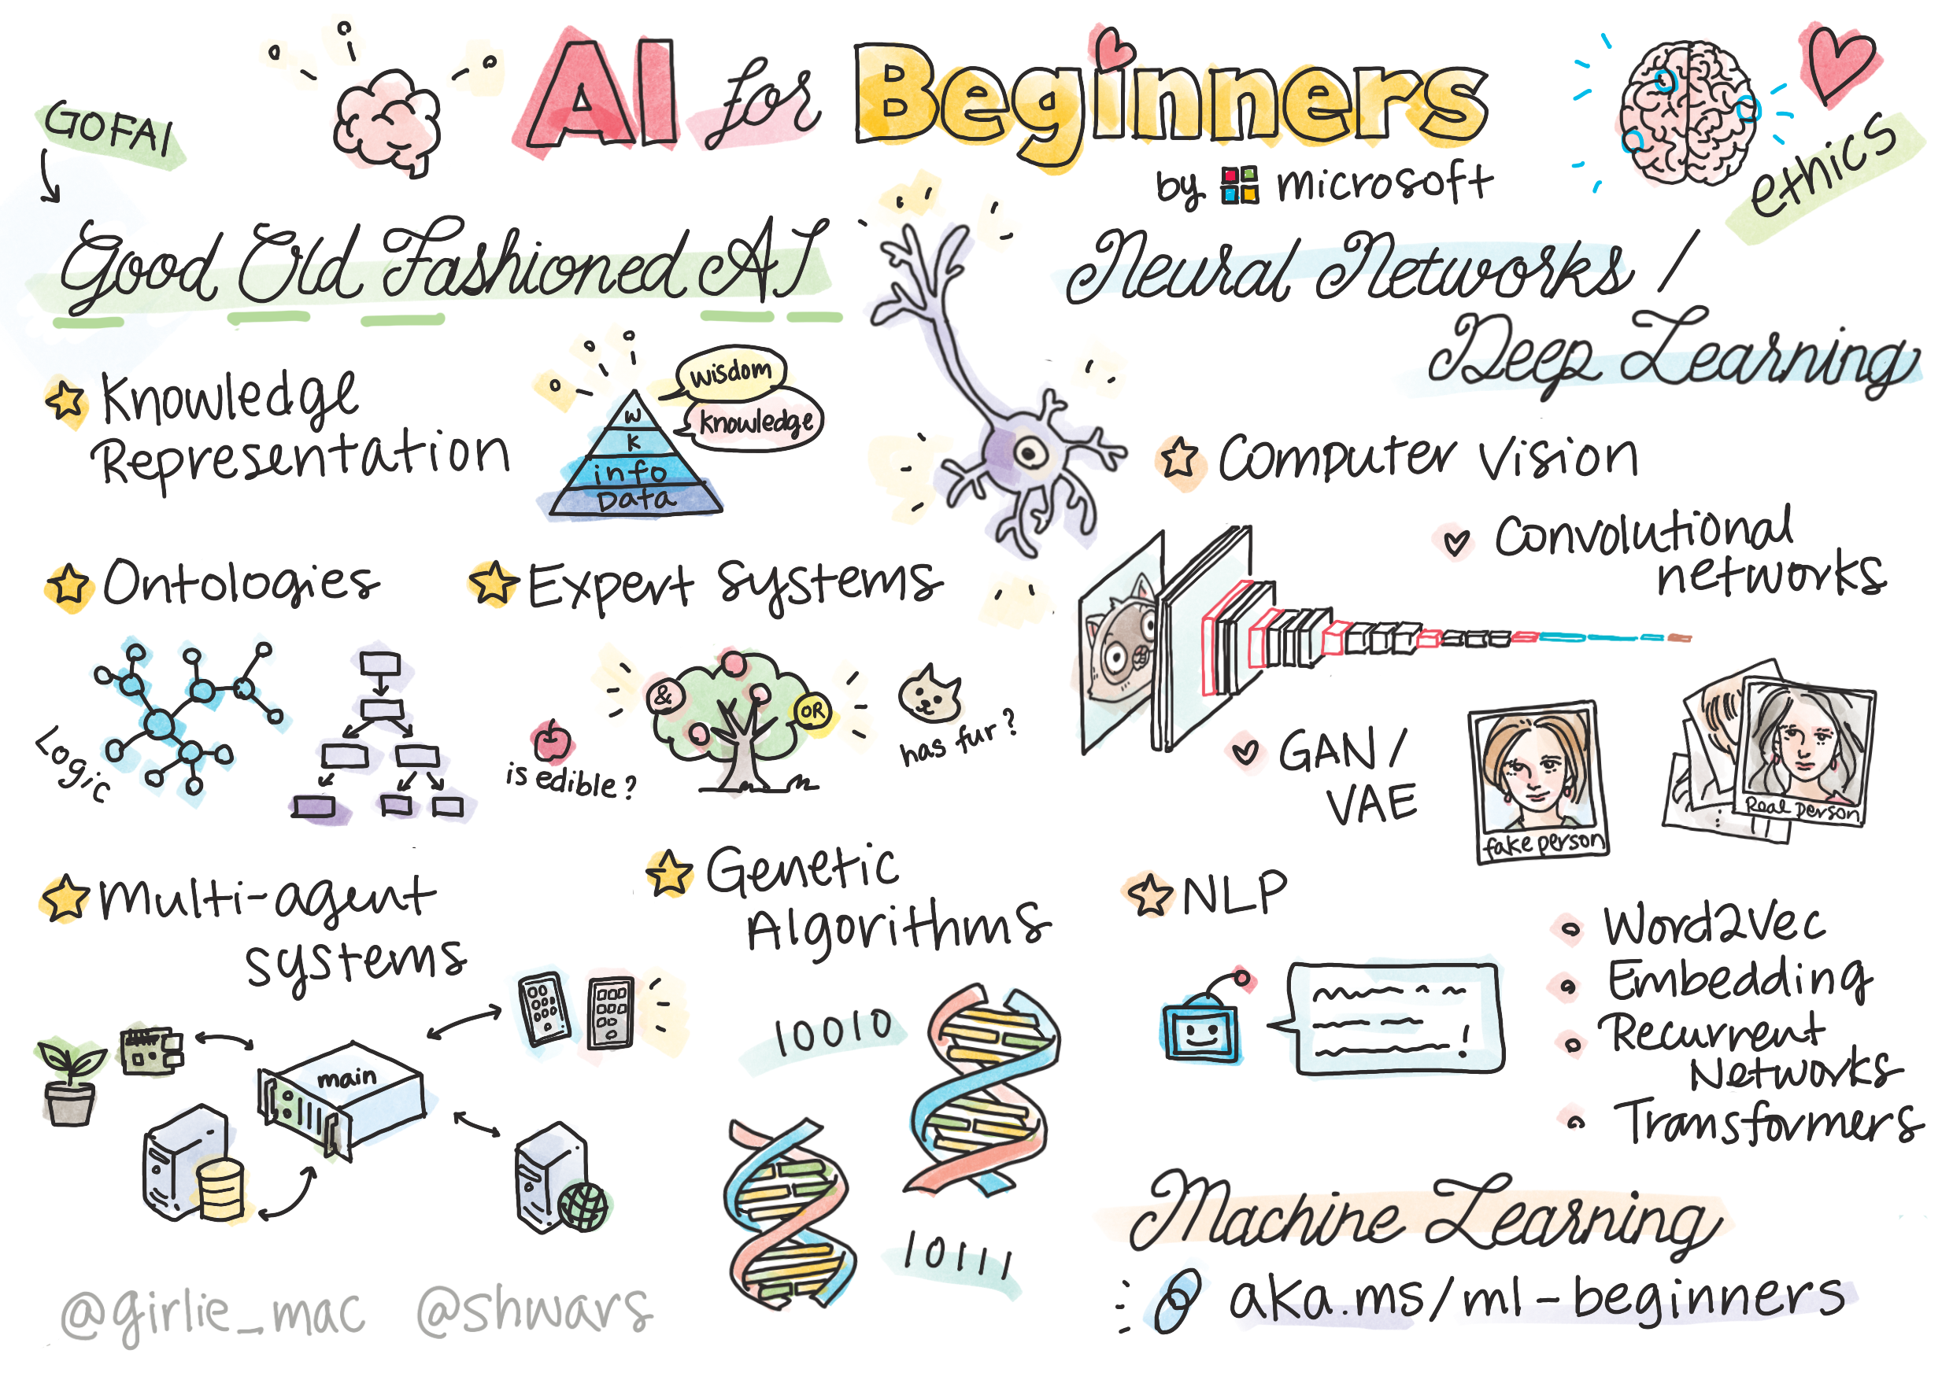

Slide 14
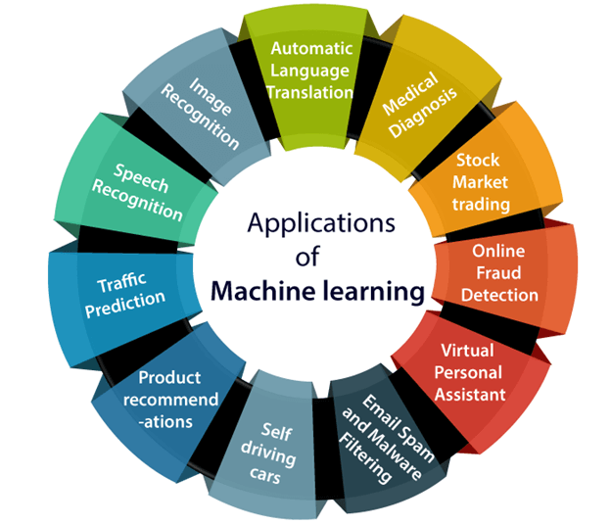

Slide 15
Artificial intelligence is a field of science concerned with building computers and machines that can
  reason,
  learn, and
  act
in such a way that would normally require human intelligence or that involves data whose scale exceeds what humans can analyze.

Slide 16
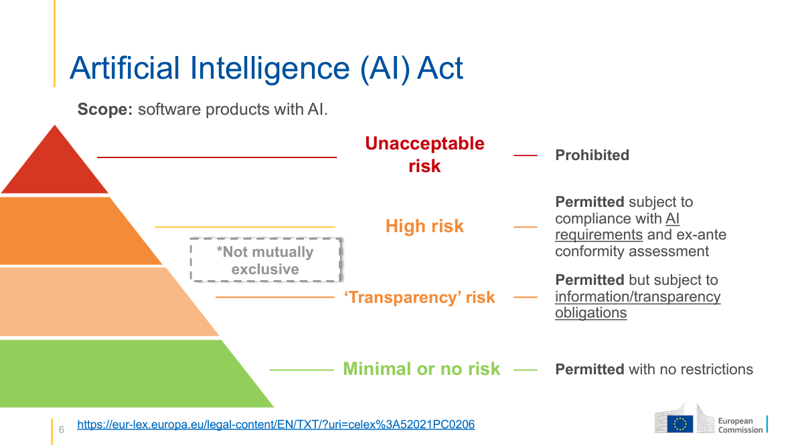

Slide 17
EU AI Act: first regulation on artificial intelligence
Different rules for different risk level
Unacceptable risk AI systems - systems considered a threat to people
  Cognitive behavioural manipulation of people or specific vulnerable groups: for example voice-activated toys that encourage dangerous behaviour in children
  Social scoring: classifying people based on behaviour, socio-economic status or personal characteristics
  Real-time and remote biometric identification systems, such as facial recognition

Slide 18
EU AI Act: first regulation on artificial intelligence
High risk - AI systems that negatively affect safety or fundamental rights
1) AI systems that are used in products falling under the EU’s product safety legislation. This includes toys, aviation, cars, medical devices and lifts.
2) AI systems falling into eight specific areas that will have to be registered in an EU database:
Biometric identification and categorisation of natural persons
Management and operation of critical infrastructure
Education and vocational training
Employment, worker management and access to self-employment
Access to and enjoyment of essential private services and public services and benefits
Law enforcement
Migration, asylum and border control management
Assistance in legal interpretation and application of the law.
All high-risk AI systems will be assessed before being put on the market and also throughout their lifecycle.

Slide 19
EU AI Act: first regulation on artificial intelligence
Generative AI
Must comply with transparency requirements:
  Disclosing that the content was generated by AI
  Designing the model to prevent it from generating illegal content
  Publishing summaries of copyrighted data used for training

Slide 20
Directorate-General for Education, Youth, Sport and Culture (DG EAC)
‘Ethical guidelines on the use of artificial intelligence (AI) and data in teaching and learning for educators
Liability:
  Methodology to identify and describe a series of case studies on harms produced by AI systems.

Slide 21
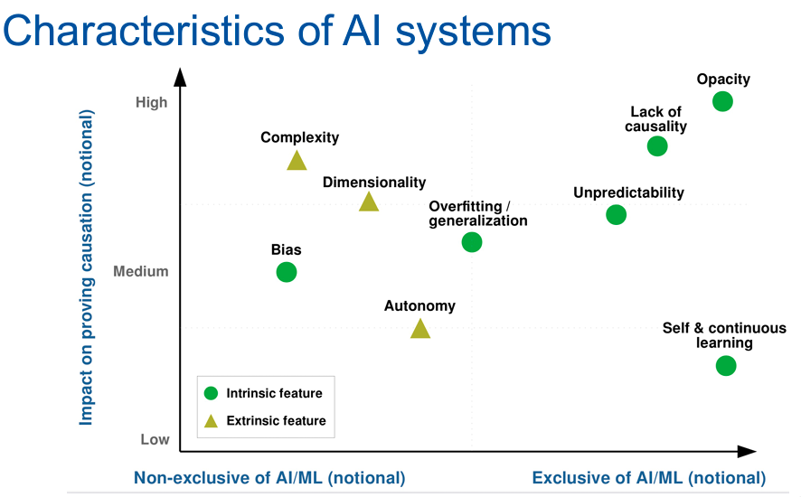

Slide 22
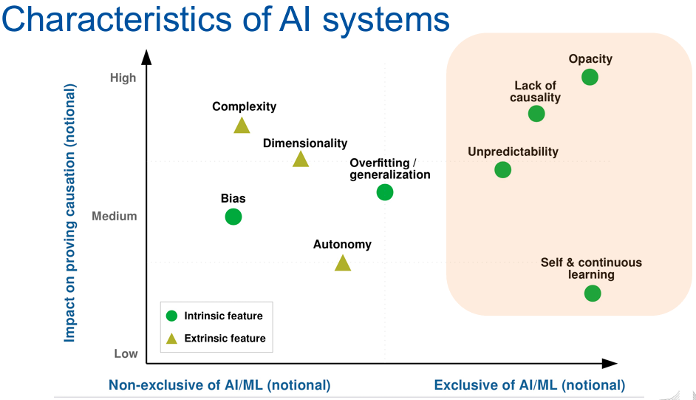

Slide 23
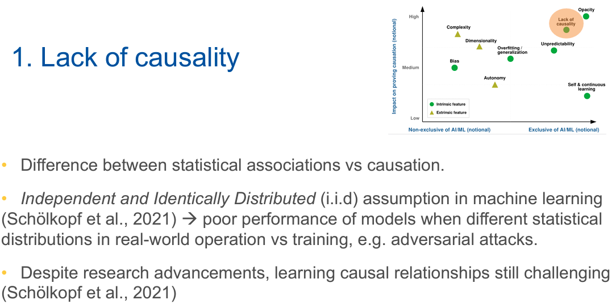

Slide 24
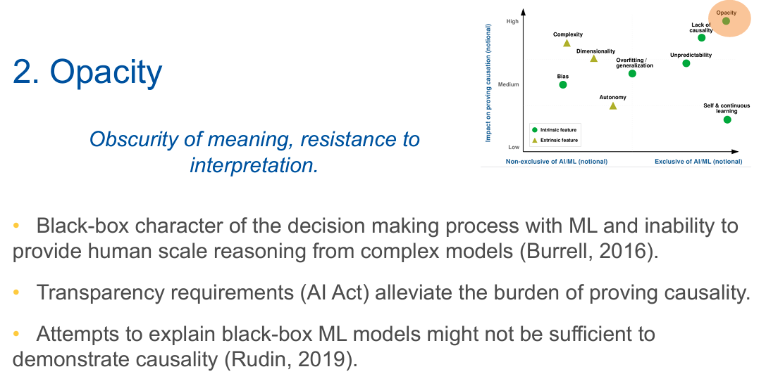

Slide 25
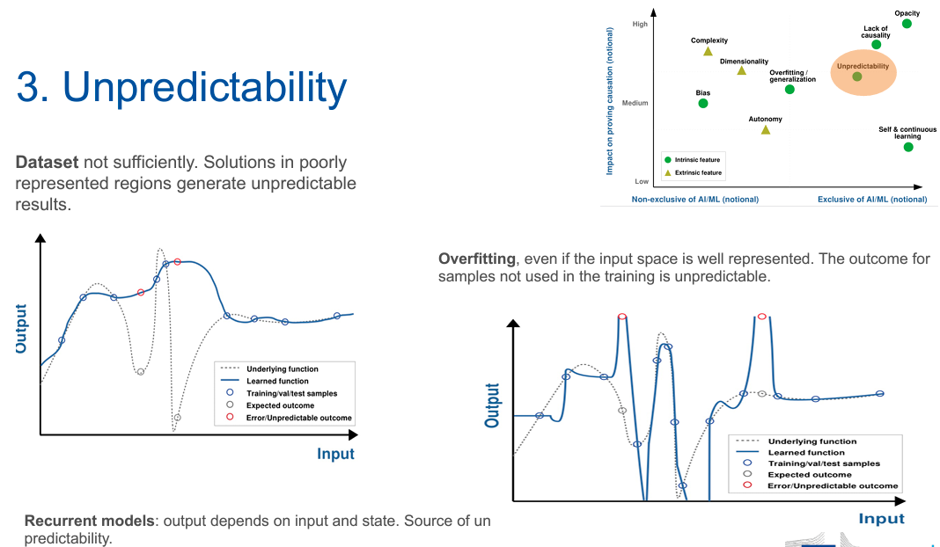

Slide 26
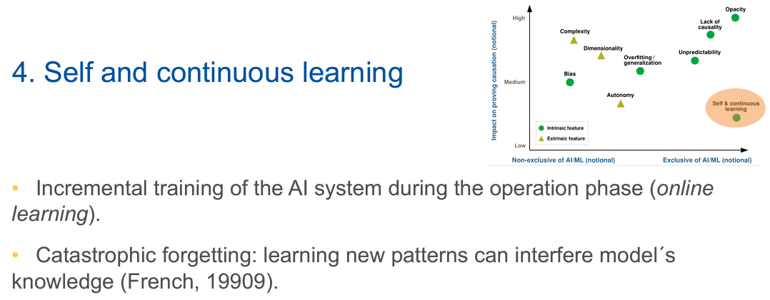

Slide 27
Gary Marcus
6 month ban on training super large #LLMs (March 22, 2023)
The letter didn't call for a ban on AI. It didn't call for a permanent ban. It didn't call for a ban on GPT-4. it didn't call for a ban on the vast majority of AI research, only for a brief pause on one very specific project with a technology that has *known* risks with no known solutions. It actually called for *more* research. Did anybody even read the letter?

Slide 28
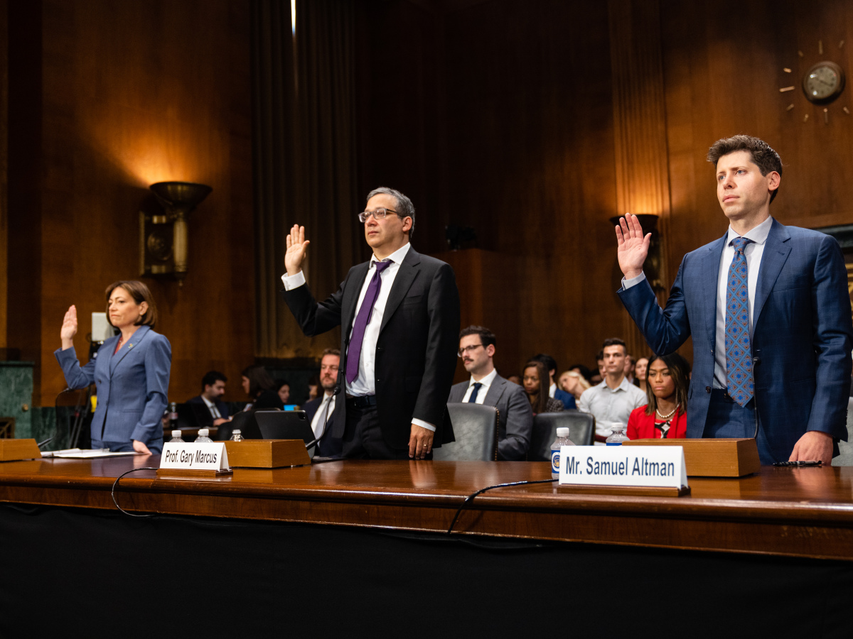
AI US Senate hearing May 16, 2023
US national agency for AI
Global agency of AI
Similar to
  FDA (U.S. Food and Drug Administration),
  CERN (European Organization for Nuclear Research)

Slide 29
Sam Altman (openai CEO)
Form a new government agency charged with licensing large AI models, and empower it to revoke that license for companies whose models don’t comply with government standards.
Create a set of safety standards for AI models, including evaluations of their dangerous capabilities. For instance, models would have to pass certain tests for safety, such as whether they could “self-replicate” and “exfiltrate into the wild” — that is, to go rogue and start acting on their own.
Require independent audits, by independent experts, of the models’ performance on various metrics.

Slide 30
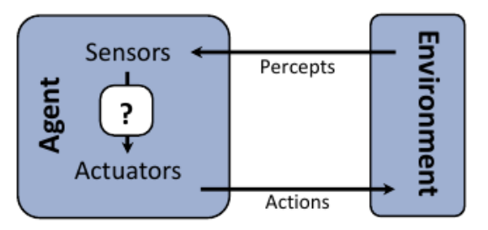
Ce e AI?

Slide 31
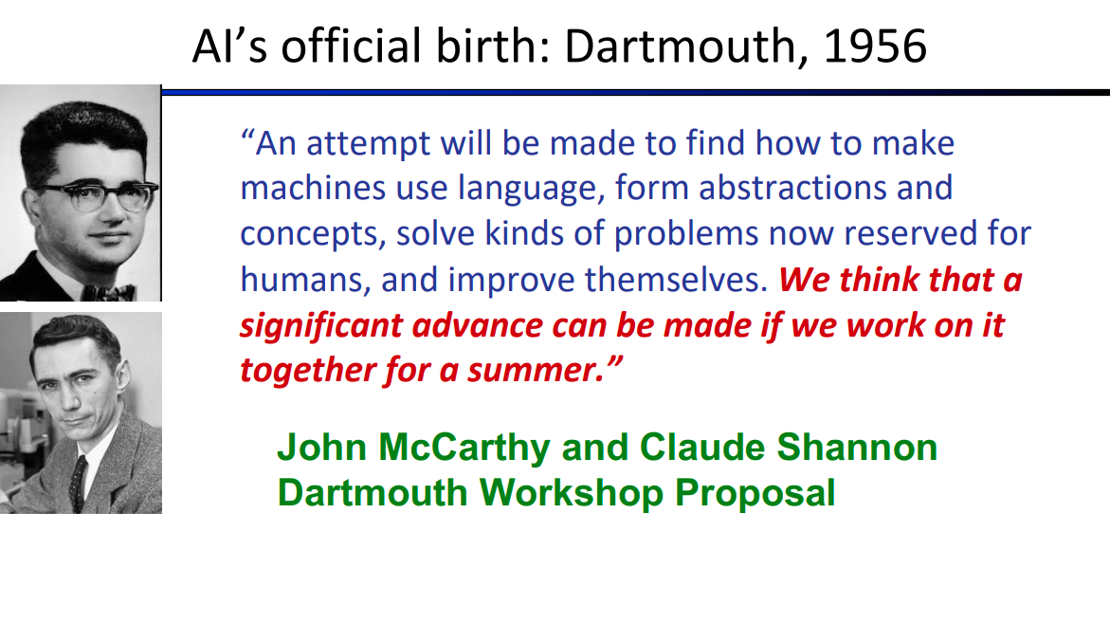
Ce e Inteligenta artificiala

Slide 32
AI
Studiul agentilor care (1) percep mediul si (2) realizeaza actiuni
The study of computations that make it possible to perceive, reason, act.
Algorithms enabled by
Constrains exposed by
Representation that support the making of
Models targeted to
  Thinking Perception Actions

Slide 33
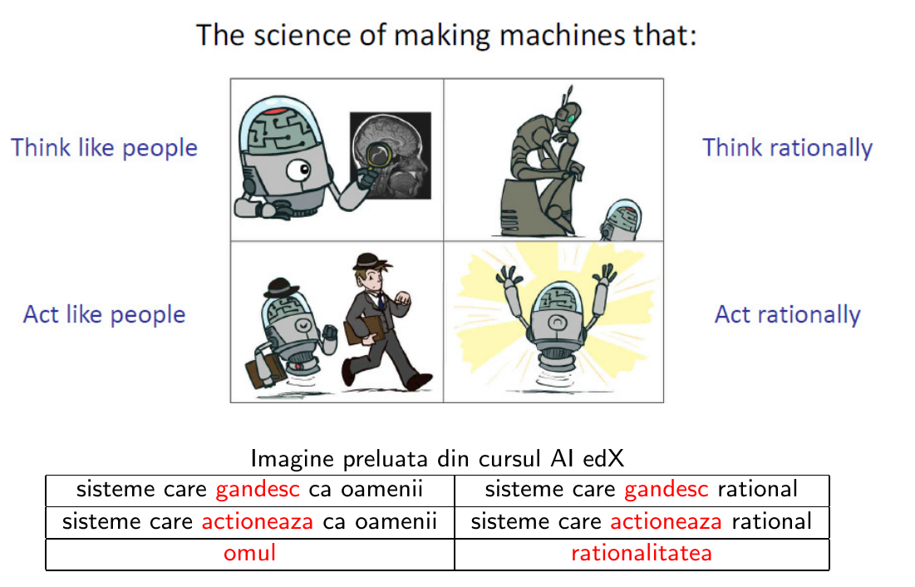
AI

Slide 34
Computational Rationality - AI
Rational – maximizarea utilitatii asteptate
Atingerea optima a obiectivelor
Caracteristici ale Perceptiilor, mediului si actiunilor -> actiunea rationala
AI – tehnici generale pentru diverse tipuri de probleme

Slide 35
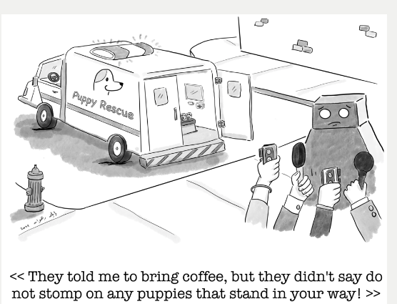
Limitari ale modelului: "agents that optimize their expected utility"
Presupune furnizarea de catre om a unui obiectiv complet specificat
Alinierea valorilor: sah - santajarea adversarului, mituirea audientei – pentru cresterea sanselor de castig = nu e comportament neinteligent, ci e consecinta logica a definirii castigului drept singul obiectiv al masinii
Beneficial machines – agentul urmareste atingerea obiectivelor noastre, pe care STIE ca nu le stie complet

Slide 36
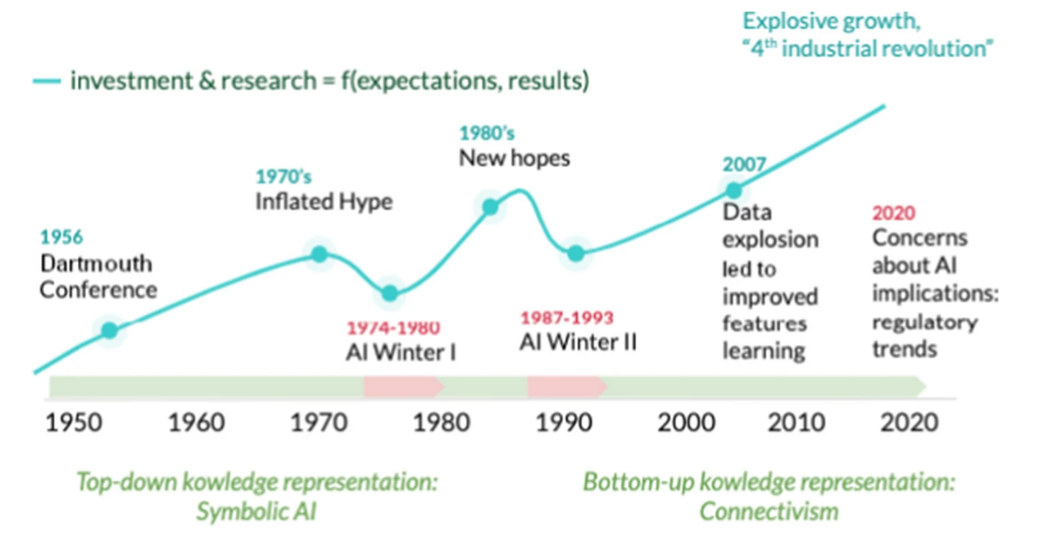
Scurta istorie a AI

Slide 37

1940-1950: Inceputurile
1943: McCulloch si Pitts: circuit boolean ca model al creierului
1950: Turing’s article Computing Machinery and Intelligence
1950 - 70: Excitement: Look, Ma, no hands!
1950s: Programe AI: Samuel’s checkers program, Newell si Simon’s Logic Theorist, Gelernter’s Geometry Engine
1956: intalnirea de la Dartmouth: a fost adoptat termenul de ”Artificial Intelligence” John McCarthy
1960: Eliza, Analogy, Vision
1966: ”the spirit is willing, but the flesh is weak” - ”the vodka is good but the meat is rotten”
1970 - 90: Abordarea bazata pe cunostinte
1969 - 79: Early development of knowledge-based systems
AI winter
1980 - 88: Expert systems industry booms - 1986 - castig $40 milioane per an
AI Winter
1990 -: Abordarea statistica
Resurgence of probability, focus on uncertainty
Deep Blue - 1997 chess Kasparov
General increase in technical depth
Agents and learning systems AI Spring
2000 -: Avant si omniprezenta; Big Data, Deep Learning

Slide 38
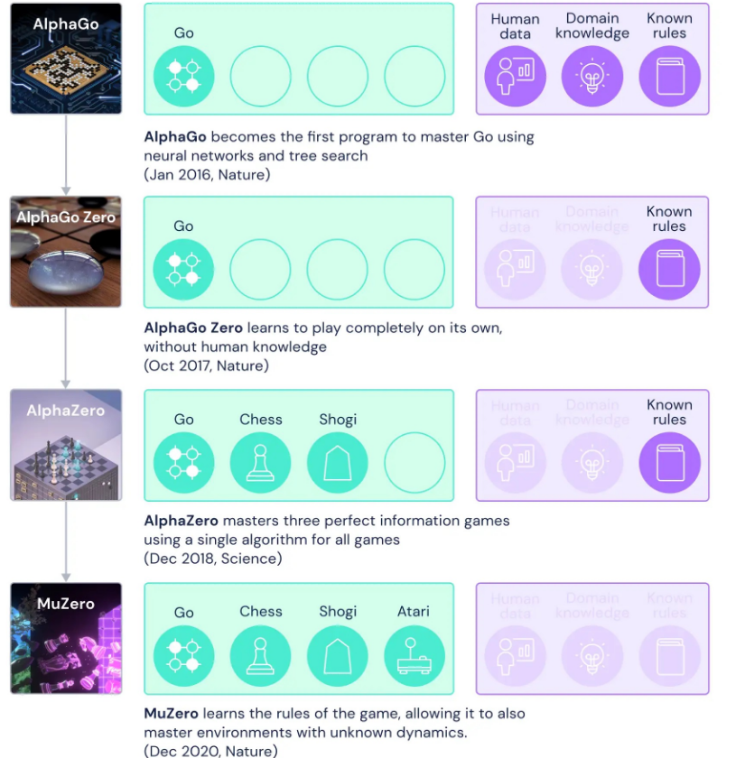
IBM Watson Jeopardy 2011
AlphaGo
Medical Images

Slide 39
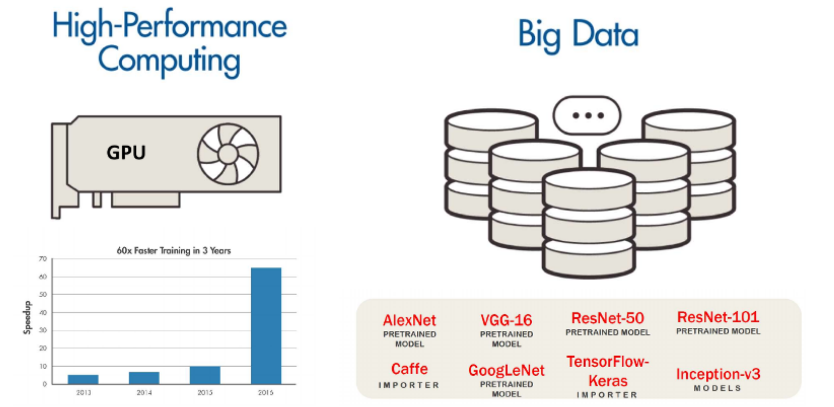
Factori care au contribuit la evolutia DeepLearning

Slide 40
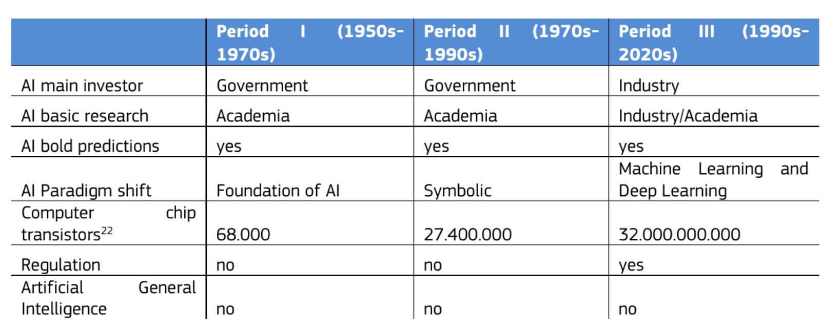

Slide 41
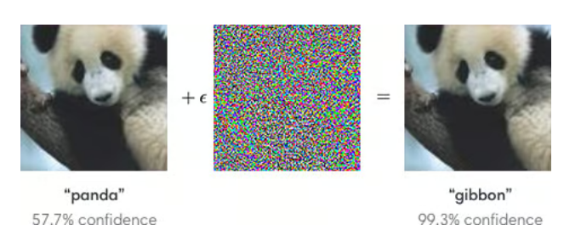
Adversarial Attacks

Slide 42

Nice to read/watch
https://www.youtube.com/watch?v=HrCIWSUXRmo
Ai index report
AI Batch

Slide 43
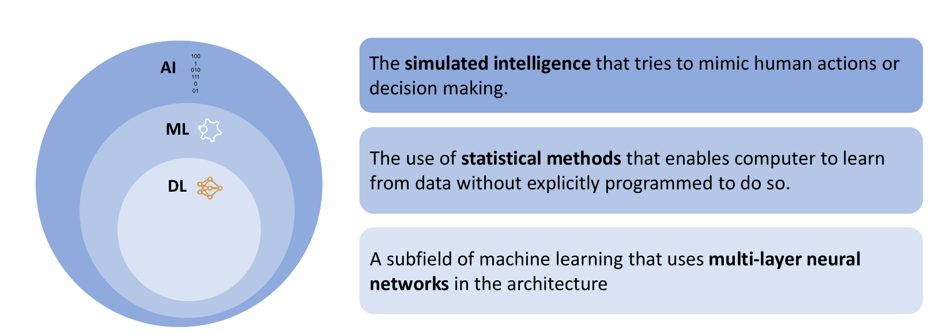

Slide 44
Intelligent agents are autonomous entities that act on a certain environment:
  1 observe the environment.
  2 have certain goals to achieve.
  3 reason over the knowledge they’re provided.
  4 act on the environment based on the results from their reasoning process

Slide 45
Agentic AI
  "Fully autonomous agents are defined by four elements that, in combination, ladder up to full agentic capability: reasoning, external memory, execution, and planning," write the authors.
  "To be clear, the fully autonomous agents of tomorrow might possess all four building blocks, but today's LLM apps and agents do not," they declare.
  "Agents emerge when you place the LLM in the control flow of your application and let it dynamically decide which actions to take, which tools to use, and how to interpret and respond to inputs,

Slide 46
Agentic design patterns
Reflection: The LLM examines its own work to come up with ways to improve it.
Tool Use: The LLM is given tools such as web search, code execution, or any other function to help it gather information, take action, or process data.
Planning: The LLM comes up with, and executes, a multistep plan to achieve a goal (for example, writing an outline for an essay, then doing online research, then writing a draft, and so on).
Multi-agent collaboration: More than one AI agent work together, splitting up tasks and discussing and debating ideas, to come up with better solutions than a single agent would.

Slide 47
Ce e AI?
Scopul cursului IA: studiul unui set de principii de design pentru construirea unor agenti rationali.
Caracteristicile perceptiilor, mediului si a spatiul de actiuni permit identificarea tehnicilor de selectie a actiunilor rationale.

Slide 48
Rationalitate – comportament bun
Un agent rational selecteaza actiunile care ii maximizeaza utilitatea asteptata. - does the right thing
agent → secv de actiuni → secv de stari ale mediului → dezirabilitate
Performance measure - criteriul de succes al comportamentului unui agent
Cum se alege aceasta masura?
  Masura de performanta - obiectiva, impusa de catre creatorul agentului.
  E mai bine ca masura de performanta sa fie aleasa in concordanta cu ce se doreste in cadrul mediului, si nu in concordanta cu modul in care un agent s-ar putea comporta.
1. cantitatea de mizerie aspirata:
2. suprafata curata de-a lungul timpului
3. aspirator care aspira mediocru dar continuu vs aspirator care aspira foarte bine dar cu intreruperi

Slide 49
Un agent rational trebuie sa selecteze
(i) pentru orice secventa de perceptii
(ii) o actiune care ii maximizeaza masura de performanta asteptata,
(iii) date fiind evidentele furnizate de perceptii si de cunostintele agentului.

Slide 50
Proprietati ale mediilor agentilor
Complet observabil vs partial observabil vs unobservable
La orice moment in timp, mediul este complet observabil daca senzorii agentului ii dau acces complet la starea mediului la fiecare moment (toate aspectele relevante in alegerea actiunii)
Determinist vs nondeterminist vs stohastic
Daca urmatoarea stare a mediului este in intregime determinata de starea curenta si de actiunile agentilor, mediul este determinist.
Episodic vs secvential
Intr-un mediu episodic, experienta agentului este impartita in episoade. Un episod consta in perceptie urmata de o singura actiune. Episoadele urmatoare nu depind de actiunile episoadelor anterioare.

Slide 51
Proprietati ale mediilor agentilor
Static vs dinamic
Daca mediul se schimba cat timp agentul decide ce actiune sa faca, mediul este dinamic.
Este mai usor de lucrat cu medii statice - agentul nu trebuie sa monitorizeze continuu mediu
in timp ce ia decizii si nici sa tina cont de timpul scurs. Daca mediul nu se schimba in timp, dar
performanta agentului da, atunci mediul este semidinamic.
Discret vs continuu
Daca timpul sau numarul de stari, perceptii sau actiuni sunt finite, mediul este discret.
Agent vs multiagent
Daca sunt mai multi agenti, mediul este multiagent.
sisteme multiagent competitive - sah
sisteme multiagent cooperative

